Slide 1

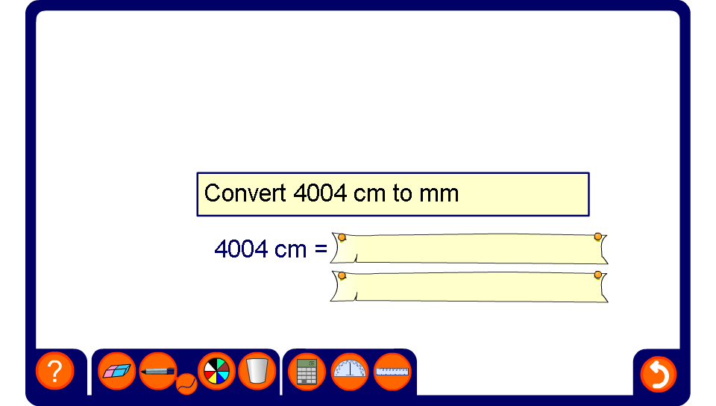


Converting metric units
Notes:
For each problem ask pupils what we have to multiply or divide by to complete the conversion before asking for the solution.

